Slide 1


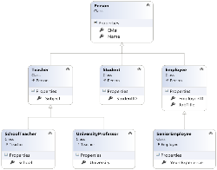

Object-Oriented Programming with Objective-C
Inheritance, Abstraction, Encapsulation, Polymorphism
Mobile apps for iPhone & iPad
Telerik Software Academy
http://academy.telerik.com
Object-Oriented

Slide 2

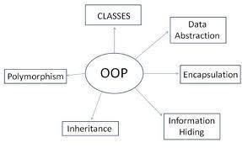
Table of Contents
OOP Principles
Inheritance
Protocols
Abstraction
Encapsulation

Slide 3

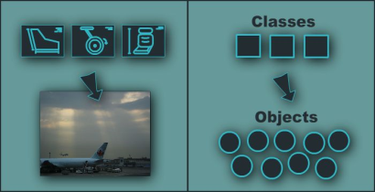
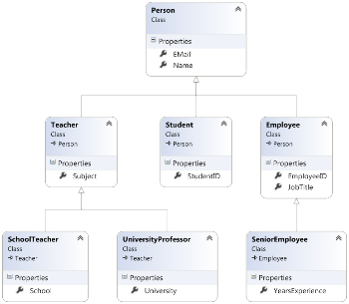
Fundamental Principles of OOP
Object-Oriented
Notes:
(c) 2006 National Academy for Software Development - http://academy.devbg.org*
3##

Slide 4
Fundamental Principles of OOP
Inheritance
Inherit members from parent class
Abstraction
Define and execute abstract actions
Encapsulation
Hide the internals of a class
Polymorphism
Access a class through its parent interface
4

Slide 5
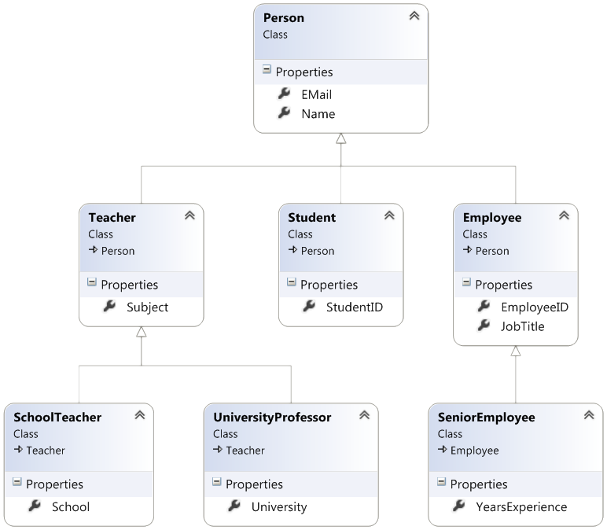
Inheritance
Notes:
(c) 2006 National Academy for Software Development - http://academy.devbg.org*
5##

Slide 6
Classes and Protocols
Classes define attributes and behavior
Fields, properties, methods, etc.
Methods contain code for execution
Protocols define a set of operations
Empty methods and properties, left to be implemented later
@interface Shape: NSObject
@end
@implementation Shape
@end
@protocol Figure
@end

Slide 7
Inheritance
Inheritance allows classes to inherit characteristics from an existing parent (super) class
Attributes (fields and properties)
Operations (methods)
A child class can extend the parent class
Add new fields and methods
Redefine methods (modify existing behavior)
A class can conform to a protocol by providing implementation for its methods
7

Slide 8
Types of Inheritance
Inheritance terminology
base class /
parent class
derived class
inherits
class
conforms to
protocol
8

Slide 9

Inheritance – Benefits
Inheritance has a lot of benefits
Extensibility
Reusability (code reuse)
Provides abstraction
Eliminates redundant code
Use inheritance for buidling is-a relationships
E.g. person is-a mammal
Don't use it to build has-a relationship
E.g. person has-a name
9
Notes:
(c) 2006 National Academy for Software Development - http://academy.devbg.org*
9##

Slide 10
Inheritance
Child classes implicitly gain all members from the super class
All fields, methods, properties
Some members are inaccessible (hidden)
The class whose methods are inherited is called base (parent) class
The class that gains new functionality is called derived (child) class

Slide 11
Inheritance – Example
Base class
Person
+Name: NSString
+Address: NSString
Derived class
Derived class
Employee
Student
+Company: NSString
+Salary: double
+School: NSString

Slide 12
Class Hierarchies
Inheritance leads to a hierarchies of classes and / or protocols in an application:
Game
SinglePlayerGame
MultiplePlayersGame
Minesweeper
Solitaire
BoardGame
…
…
Chess
Backgammon
12

Slide 13
Inheritance in Objective-C
A class can inherit only one base class
E.g. NSMutableArray derives from NSArray
A class can conform to several protocols
This is Obj-C’s form of multiple inheritance
Shape conforms to Movable and Drawable
13

Slide 14

How to Define Inheritance?
Specify the name of the base class after the name of the derived (with colon)
@interface Person: NSObject
@property (strong, nonatomic) NSString* firstname;
@property (strong, nonatomic) NSString* lastname;
@end
@interface Ninja: Person
@property int rank;
@end

Slide 15
How to Define Inheritance?
Specify the name of the base class after the name of the derived (with colon)
@interface Person: NSObject
@property (strong, nonatomic) NSString* firstname;
@property (strong, nonatomic) NSString* lastname;
@end
@interface Ninja: Person
@property int rank;
@end
Inherits properties firstname and lastname from Person

Slide 16
How to Define Inheritance?
Specify the name of the base class after the name of the derived (with colon)
@interface Person: NSObject
@property (strong, nonatomic) NSString* firstname;
@property (strong, nonatomic) NSString* lastname;
@end
@interface Ninja: Person
@property int rank;
@end
Inherits properties firstname and lastname from Person
Adds new property

Slide 17
Simple Inheritance Example
@interface Person: NSObject
-(instancetype) initWithFirstname: (NSString *) fname
andLastname: (NSString *) lname;
-(void) introduce;
-(void) walk;
@end
@implementation Person
@synthesize firstname; @synthesize lastname;
-(instancetype) initWithFirstname: (NSString *) fname
andLastname: (NSString *) lname{
}
-(void) introduce{
}
-(void) walk{
}
@end

Slide 18
Simple Inheritance Example
@interface Ninja: Person
@property int rank;
-(instancetype) initWithRank: (int) rank;
-(void) fight;
@end
@implementation Ninja
@synthesize rank;
-(instancetype) initWithRank: (int) rank{
self = [super initWithFirstname: @"[Unknown]"
andLastname: @"[Unknown]"];
self.rank = rank;
return self;
}
-(void) walk{
}
-(void) fight{
}
@end

Slide 19
Simple Inheritance Example
@interface Ninja: Person
@property int rank;
-(instancetype) initWithRank: (int) rank;
-(void) fight;
@end
Adds new property – rank
Adds new method – fight
@implementation Ninja
@synthesize rank;
-(instancetype) initWithRank: (int) rank{
self = [super initWithFirstname: @"[Unknown]"
andLastname: @"[Unknown]"];
self.rank = rank;
return self;
}
-(void) walk{
}
-(void) fight{
}
@end

Slide 20
Simple Inheritance Example
@interface Ninja: Person
@property int rank;
-(instancetype) initWithRank: (int) rank;
-(void) fight;
@end
Adds new property – rank
Adds new method – fight
@implementation Ninja
@synthesize rank;
-(instancetype) initWithRank: (int) rank{
self = [super initWithFirstname: @"[Unknown]"
andLastname: @"[Unknown]"];
self.rank = rank;
return self;
}
-(void) walk{
}
-(void) fight{
}
@end
Overwrites the method from the parent

Slide 21


Simple Inheritance
Live Demo

Slide 22
Inheritance: Important Aspects
In Objective-C there is no multiple inheritance
Yet, a class can conform to multiple protocols
Class members are also inherited
Init methods are inherited
Inheritance is transitive relation
If C is derived from B, and B is derived from A, then C inherits A as well

Slide 23
Inheritance: Important Features
When a derived class extends its base class
It can freely add new members
Cannot remove derived ones
Declaring new members with the same name or signature overwrites the inherited ones
A class may not provide implementation to some methods
Derived classes can provide the implementation

Slide 24



Abstraction
Notes:
(c) 2006 National Academy for Software Development - http://academy.devbg.org*
24##

Slide 25

Abstraction
Abstraction means ignoring irrelevant features, properties, or functions and emphasizing the relevant ones ...
... relevant to the given project
With an eye to future reuse in similar projects
Abstraction helps managing complexity
"Relevant" to what?
25

Slide 26
Abstraction (2)
Abstraction is something we do every day
Looking at an object, we see those things about it that have meaning to us
We abstract the properties of the object, and keep only what we need
E.g. students get "name" but not "color of eyes"
Allows us to represent a complex reality in terms of a simplified model
Abstraction highlights the properties of an entity that we need and hides the others
26

Slide 27

Abstraction in .NET
In Objective-C object-oriented programming abstraction is achieved in several ways:
Protocols
Inheritance
Control
+click()
ButtonBase
+Color : long
Button
RadioButton
CheckBox
27

Slide 28
Protocols
An protocol defines a set of messages (methods) that given object should perform
Also called "contract" for providing a set of operations
Defines abstract behavior
Protocols provide abstractions
You invoke the abstract actions
Without worrying how it is internally implemented
28

Slide 29
Protocols(2)
Protocols describe a prototype of group of methods (operations) or properties
Can be conformed by a given class
Define only the prototypes of the operations
No concrete implementation is provided
Can be used to define abstract data types
Can not be instantiated
Can contain optional and required members

Slide 30
Protocols – Example
@protocol Shape
@property double x;
@property double y;
-(void) moveToX:(double) x andY: (double) y;
-(double) calculateSurface;
-(double) calculateArea;
@end
@protocol Resizable
@property double width;
@property double height
-(void) resizeWidth: (double) width;
-(void) resizeHeight: (double) height;
-(void) resizeWidth: (double) width
andHeight: (double) weighty;
@end

Slide 31
Protocols Implementation
Classes can conform to one or several protocols
@interface Rectangle : NSObject<Shape>
-(instancetype) initWithX: (double) x
y: (double) y
width: (double) width
andHeight: (double) height;
@end;
Implementer classes must conform all methods and properties of the protocol

Slide 32
Interface Implementation (2)
@interface Rectangle: NSObjet<Shape, Resizable>
// Rectangle specific declarations
@end
@implementation Rectangle
@synthesize x; @synthesize y;
@synthesize width; @synthesize height;
-(void) moveToX:(double) x
andY: (double) y { /* implementation */ }
-(double) calculateSurface { /* implementation */ }
-(double) calculateArea { /* implementation */ }
-(void) resizeWidth: (int) width { /* implementation */ }
-(void) resizeHeight: (int) height { /* implementation */ }
-(void) resizeWidth: (int) width
andHeight: (int) weighty { /* implementation */ }
@end

Slide 33

Protocols and Implementations
Live Demo

Slide 34


Encapsulation
Notes:
(c) 2006 National Academy for Software Development - http://academy.devbg.org*
34##

Slide 35
Encapsulation
Encapsulation hides the implementation details
Class announces some operations (methods) available for its clients – its public interface
All data members (fields) of a class should be hidden
Accessed via properties (read-only and read-write)
No interface members should be hidden
35

Slide 36
Encapsulation – Example
Data fields are private
Init methods and accessors are defined (getters and setters)
Person
-_name : NSString
-_age : int
+initWith: (NSString*) name
andAge: (int) age
+name : NString
+age : int
36

Slide 37
Encapsulation in .NET
Fields are always declared private
They cannot be public anyway
Init methods are almost always declared public
Protocol members are always public
Non-interface members are declared private / protected
37

Slide 38
Encapsulation – Benefits
Ensures that structural changes remain local:
Changing the class internals does not affect any code outside of the class
Changing methods' implementation does not reflect the clients using them
Encapsulation allows adding some logic when accessing client's data
E.g. validation on modifying a property value
Hiding implementation details reduces complexity → easier maintenance
38

Slide 39
Encapsulation
Live Demo
Notes:
(c) 2006 National Academy for Software Development - http://academy.devbg.org*
39##

Slide 40
Object-Oriented Programming with Objective-C
http://academy.telerik.com

Slide 41
Homework
Implement classes for a simple Mortal Kombat game
Create characters that have name, set of skills, life and power
Different characters have different skills
Characters can punch, kick or use a skill
They cannot use a skill, if the power is not enough
Kicks and punches take damage and product power
Skills take damage and consume part of the power of the character

Slide 42
Homework (2)
(Cont.) Implement classes for a simple Mortal Kombat game
Create 5 different characters with different skills
Use protocols and inheritance
Write a method to test the functionality
Use abstraction, encapsulation and polymorphism

Slide 43
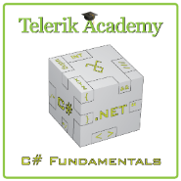



Free Trainings @ Telerik Academy
C# Programming @ Telerik Academy
csharpfundamentals.telerik.com
Telerik Software Academy
academy.telerik.com
Telerik Academy @ Facebook
facebook.com/TelerikAcademy
Telerik Software Academy Forums
forums.academy.telerik.com

